Slide 1

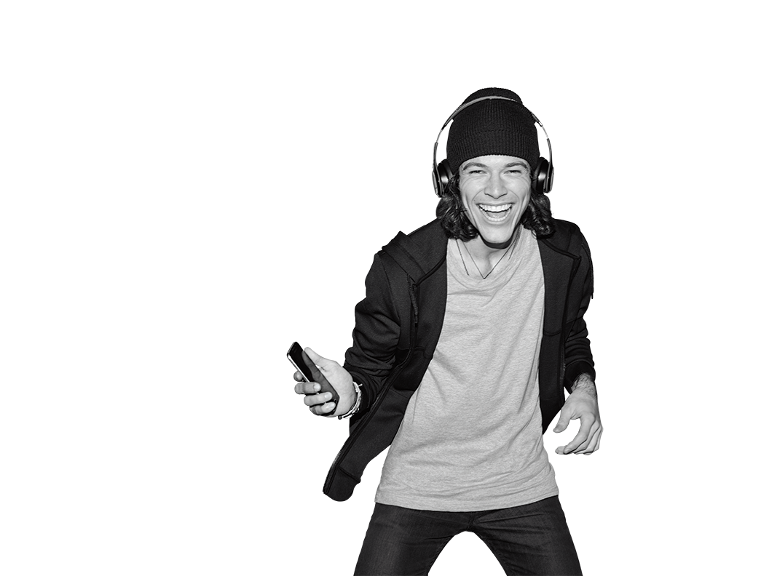


TR# 2017325

Slide 2


UCE
Interaction Model
2 – UCE Interaction Model
T-Mobile confidential and proprietary information. Not for customer distribution.

Slide 3
INTRO
Helps you deliver the best customer experience ever!
Lets you be yourself and meet the customers on their terms.
Helps you build and deepen customer relationships, so you can be successful!
3 – UCE Interaction Model
T-Mobile confidential and proprietary information. Not for customer distribution.

Slide 4
INTRO
Interaction Model Learning Hub
Mission Control
Overview (421469)
4 – UCE Interaction Model
T-Mobile confidential and proprietary information. Not for customer distribution.

Slide 5

INTRO
Make It Personal
Explore & Discover
Problem Solved
Guide the Purchase
Stay Connected
5 – UCE Interaction Model
T-Mobile confidential and proprietary information. Not for customer distribution.

Slide 6
MAKE IT PERSONAL
Interaction Model Learning Hub
Mission Control
Make It Personal (421513)
6 – UCE Interaction Model
T-Mobile confidential and proprietary information. Not for customer distribution.

Slide 7
MAKE IT PERSONAL
Be Your Un-carrier Self.
Let your personality show!
Use everyday language and personal experiences.
Invite the customers to be themselves, by being yourself.
7 – UCE Interaction Model
T-Mobile confidential and proprietary information. Not for customer distribution.

Slide 8
MAKE IT PERSONAL
Have a two-way conversation.
Seek to understand.
Get side-by-side, share your tools, and show the customer what you see.
Listen, ask questions, involve the customer.
8 – UCE Interaction Model
T-Mobile confidential and proprietary information. Not for customer distribution.

Slide 9
MAKE IT PERSONAL
Spend time on what matters.
Start with why the customer came in.
Tailor the conversation to the customer’s interests and needs.
9 – UCE Interaction Model
T-Mobile confidential and proprietary information. Not for customer distribution.

Slide 10
MAKE IT PERSONAL
Match needs to Un-carrier moves.
Ask customers to tell you about their experiences and pain points.
Guide the conversation to match customer needs to Un-carrier moves.
10 – UCE Interaction Model
T-Mobile confidential and proprietary information. Not for customer distribution.

Slide 11
MAKE IT PERSONAL
Have serious fun.
Provide the best service experience ever.
Be curious about the person you’re working with.
Build a T-Mobile relationship.
Acknowledge tenure and celebrate existing customers.
11 – UCE Interaction Model
T-Mobile confidential and proprietary information. Not for customer distribution.

Slide 12
EXPLORE & DISCOVER
Interaction Model Learning Hub
Mission Control
Explore & Discover (421468)
12 – UCE Interaction Model
T-Mobile confidential and proprietary information. Not for customer distribution.

Slide 13
EXPLORE & DISCOVER
Explore hands-on, side-by-side.
Suggest things to explore and help them.
Use interactive displays and devices.
Get next to your customer with your REMO tablet.
13 – UCE Interaction Model
T-Mobile confidential and proprietary information. Not for customer distribution.

Slide 14
EXPLORE & DISCOVER
Own our network.
Speak about our 4G LTE network with confidence!
Use Personal Coverage Check (PCC), LTE Comparison map, and speed tests.
Report any network issues, using #FIX.
14 – UCE Interaction Model
T-Mobile confidential and proprietary information. Not for customer distribution.

Slide 15
EXPLORE & DISCOVER
Demonstrate products and features.
Customize demonstrations to your customer’s interests.
Put the device in the customer’s hands.
Guide them as they navigate.
15 – UCE Interaction Model
T-Mobile confidential and proprietary information. Not for customer distribution.

Slide 16
EXPLORE & DISCOVER
Offer competitive comparison.
Own how we stack up against the competition.
Show your expertise!
16 – UCE Interaction Model
T-Mobile confidential and proprietary information. Not for customer distribution.

Slide 17
EXPLORE & DISCOVER
Match their pace.
Pay attention to your customer’s pace.
Use the customer’s verbal and non-verbal cues to match them.
17 – UCE Interaction Model
T-Mobile confidential and proprietary information. Not for customer distribution.

Slide 18
PROBLEM SOLVED
Interaction Model Learning Hub
Mission Control
Problem Solved (421511)
18 – UCE Interaction Model
T-Mobile confidential and proprietary information. Not for customer distribution.

Slide 19
PROBLEM SOLVED
Listen, show empathy, and apologize.
Use eye contact and body language.
Listen and confirm understanding.
Be sincere and use empathy.
19 – UCE Interaction Model
T-Mobile confidential and proprietary information. Not for customer distribution.

Slide 20
PROBLEM SOLVED
Appreciate routine transactions.
Thank every customer and show appreciation.
Assure them you are here to help.
20 – UCE Interaction Model
T-Mobile confidential and proprietary information. Not for customer distribution.

Slide 21
PROBLEM SOLVED
Take ownership.
Don’t shy away from the problem.
Stay with the customer until you have a resolution.
Make it personal – don’t take it personal.
21 – UCE Interaction Model
T-Mobile confidential and proprietary information. Not for customer distribution.

Slide 22
PROBLEM SOLVED
Focus on resolution.
Be confident and set realistic expectations.
Always try to resolve issues in-store.
Use empathy and respond to escalated situations with care.
22 – UCE Interaction Model
T-Mobile confidential and proprietary information. Not for customer distribution.

Slide 23
PROBLEM SOLVED
Use resources and tools.
Grand Central
MyT-Mobile
T-Mobile App
C2
RSL
23 – UCE Interaction Model
T-Mobile confidential and proprietary information. Not for customer distribution.

Slide 24
PROBLEM SOLVED
Follow up.
Check back in with your customers.
Keep your commitments.
24 – UCE Interaction Model
T-Mobile confidential and proprietary information. Not for customer distribution.

Slide 25
GUIDE THE PURCHASE
Interaction Model Learning Hub
Mission Control
Guide the Purchase (421512)
25 – UCE Interaction Model
T-Mobile confidential and proprietary information. Not for customer distribution.

Slide 26
GUIDE THE PURCHASE
Ask personalized questions.
Uncover pain points.
Ask follow-up questions, to further understanding.
26 – UCE Interaction Model
T-Mobile confidential and proprietary information. Not for customer distribution.

Slide 27
GUIDE THE PURCHASE
Uncover T-Mobile for Business needs.
Look and listen for clues.
Ask questions that open up the conversation to identify T-Mobile for Business opportunities.
27 – UCE Interaction Model
T-Mobile confidential and proprietary information. Not for customer distribution.

Slide 28
GUIDE THE PURCHASE
Explain “Why T-Mobile.”
Share our Un-carrier story, our network, and our offers!
Use what excites you as inspiration.
28 – UCE Interaction Model
T-Mobile confidential and proprietary information. Not for customer distribution.

Slide 29
GUIDE THE PURCHASE
Share product, network, and competitive expertise.
Show your knowledge about the industry and T-Mobile.
Make customer-focused recommendations.
29 – UCE Interaction Model
T-Mobile confidential and proprietary information. Not for customer distribution.

Slide 30
GUIDE THE PURCHASE
Give your personal recommendations.
Use your personal experiences.
Share what you love!
30 – UCE Interaction Model
T-Mobile confidential and proprietary information. Not for customer distribution.

Slide 31
GUIDE THE PURCHASE
Overcome hesitations.
Acknowledge, understand, and respond.
Respect the customer, while moving the conversation forward.
Always respond to customer hesitations!
31 – UCE Interaction Model
T-Mobile confidential and proprietary information. Not for customer distribution.

Slide 32
GUIDE THE PURCHASE
Drive the purchase decision.
Guide the customer to a purchase decision.
Respond to hesitations.
Follow up.
32 – UCE Interaction Model
T-Mobile confidential and proprietary information. Not for customer distribution.

Slide 33
STAY CONNECTED
Interaction Model Learning Hub
Mission Control
Stay Connected (421470)
33 – UCE Interaction Model
T-Mobile confidential and proprietary information. Not for customer distribution.

Slide 34
STAY CONNECTED
Put the device in their hand, ready to go.
Help them start using it immediately!
Complete the basic set-up.
Show them how to use the features they need.
34 – UCE Interaction Model
T-Mobile confidential and proprietary information. Not for customer distribution.

Slide 35
STAY CONNECTED
Set the right expectations.
Let customers know what will be on their first bill.
Rate plan
Value added services
Device payments
Review anything else that meets their needs.
35 – UCE Interaction Model
T-Mobile confidential and proprietary information. Not for customer distribution.

Slide 36
STAY CONNECTED
Review the self-serve options.
Review MyT-Mobile App.
Help
Account access
Bill payment
Access MyT-Mobile App.
36 – UCE Interaction Model
T-Mobile confidential and proprietary information. Not for customer distribution.

Slide 37
STAY CONNECTED
Connect on their terms.
Find out how they want to stay connected.
Make sure they know how to reach you.
When you follow up, be prepared with questions specific to their needs.
37 – UCE Interaction Model
T-Mobile confidential and proprietary information. Not for customer distribution.

Slide 38
STAY CONNECTED
Offer to help friends and family.
Tell them about our referral program.
Promote your expertise!
Ask for customer feedback.
38 – UCE Interaction Model
T-Mobile confidential and proprietary information. Not for customer distribution.

Slide 39
UCE CUSTOMER SURVEY
Customers:
Rate their experience
Rate their likelihood to recommend T-Mobile
Can request contact
Mobile Associates will immediately impact results
39 – UCE Interaction Model
T-Mobile confidential and proprietary information. Not for customer distribution.

Slide 40

LEARNING HUB
Learning tools:
Articles
Videos
Games
Assessments & quizzes
40 – UCE Interaction Model
T-Mobile confidential and proprietary information. Not for customer distribution.

Slide 41
DO IT YOURSELF
45 MIN
LEARN
REFLECT
Complete the following Interaction Model Missions on the Learning Hub or Cornerstone.
What hesitations have you personally had about wireless service?
How can you ensure you’re offering products and services that meet your customer’s needs and reduce hesitations?
Make It Personal
Be your Un-carrier Self
Have a Two Way Conversation
Match Your Customer’s Interests
Problem Solved
Listen, Show Empathy & Apologize
Listen & Resolve
Follow Up
Stay Connected
Put the Device in their Hand Ready to Go
Set the Right Expectations
Explore & Discover
Demonstrate Products & Features
Explore & Discover our Network
Guide the Purchase
Ask Personalized Questions
Explain Why T-Mobile
Share Product, Service & Network Expertise
41 – UCE Interaction Model
T-Mobile confidential and proprietary information. Not for customer distribution.

Slide 42

The Download
What hesitations have you personally had about wireless?
How can you ensure you’re offering products and services that meet your customer’s needs and reduce hesitations?
Which missions stood out the most to you and why?
What element of the Interaction Model are you most excited about?
42 – UCE Interaction Model
T-Mobile confidential and proprietary information. Not for customer distribution.

